Slide 1
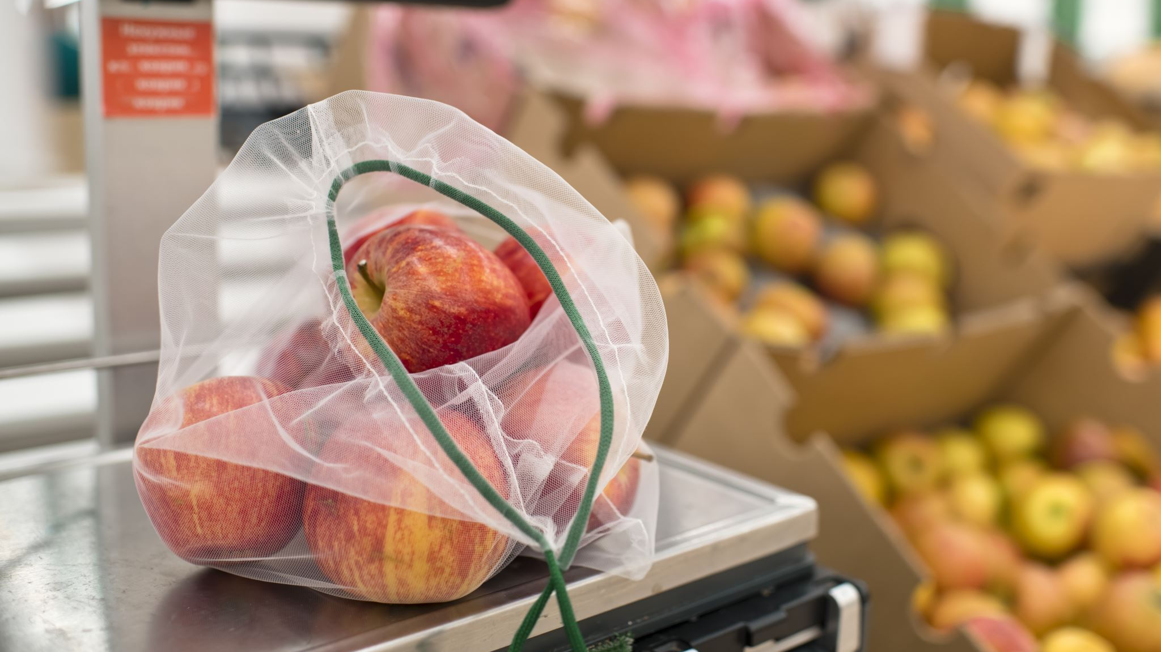
Image Processing Fruit Classification Project

Slide 2
Introduction
Technology helps us simplify our lives and make hard tasks take less time and effort. One of the most important sectors in AI is image processing. Image processing can read thousands of pictures in a few seconds, recognize it and extracts features. Our project aims to identify if a fruit is fresh or rotten by using the CNN deep learning algorithm and achieve a high accuracy.

Slide 3
Comparison of the proposed model with the benchmark studies
Study | Number of features | Technique(only the technique that produced best result) | Accuracy | Precision | Recall
https://ieeexplore.ieee.org/abstract/document/9563427/references#references | Undetermined | SVM | 99 | 86 | 95
Proposed | 464 | CNN | 93 | 50 | 100

Slide 4
Description of the Dataset
Our Dataset contain a total of 5,031 images of rotten and fresh apples. We decided to use a deep learning technique which is CNN algorithm. we split the data into 3 parts, Train with 80% of the data, Test with 1.9% of the data, Validation with 17.8% of the data.

Slide 5
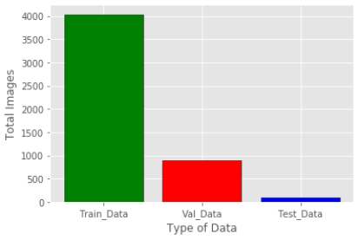
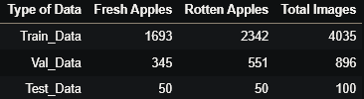
Statistical Analysis of the Dataset

Slide 6
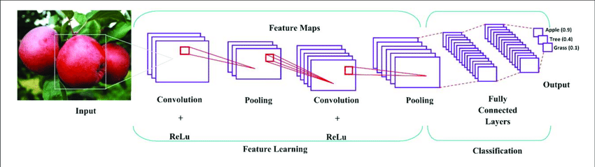
CNN Model

Slide 7
Conclusion
At the end of this project, we have used 5,031 images with CNN Technique in order to get the highest accuracy rate at the moment. It is possible to add more images and increase the accuracy of the model, but this requires high-performance computers.

